Slide 1
Cambridgeshire and Peterborough
Integrated Care System
LPC AGM
21 September 2021
Brampton Park Golf Club

Slide 2
What is an ICS?
500,000 to
3,000,000 residents
CCG to ICS
42 ICS
Integrated care systems (ICSs) are partnerships that bring together providers and commissioners of NHS services across a geographical area with local authorities and other local partners to collectively plan health and care services to meet the needs of their population. The central aim of ICSs is to integrate care across different organisations and settings, joining up hospital and community-based services, physical and mental health, and health and social care.
IN/PCNs
(30-50,000)
Places
(250,000 - 500,000)
Systems
(1 – 3m)
Cradle to grave
Toe to head
Commissioners & Providers
1 April 2022

Slide 3
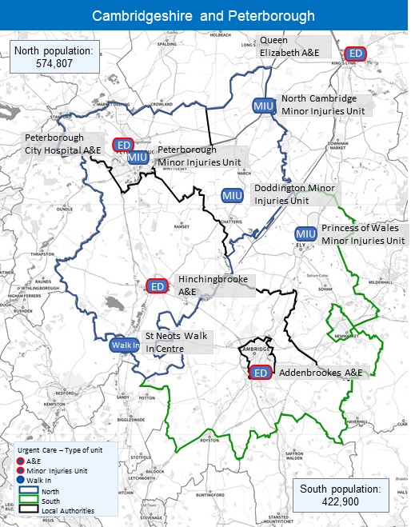
What makes up Cambridgeshire and
Peterborough Integrated Care System?
Our partnership is composed of NHS providers (acute, community (including pharmacy, dentistry and optometry, mental health, ambulance), our CCG and GP practices, County and District Councils, our Health and Wellbeing Board, Healthwatch, LMC, LPC, LDC, LOC, voluntary care, and other partners.
By working in true partnership, health and care organisations are better able to improve the health and wellbeing in our area.
Putting the local people at the heart of everything we do.
Improve outcomes in population health and healthcare
Tackle inequalities in outcomes, experience and access
Enhance productivity and value for money
Help the NHS support social & economic development

Slide 4
What will this mean for our population?
Outcome based healthcare
Shared patient record
Seamless patient journey
Improved patient experience

Slide 5
What are our goals and key priorities?
Care closer to home
Self care
Personalised care
Data driven
Inequalities
Population Health

Slide 6
Delegated Commissioning: The Primary Care Family
(together at last)!
Community Pharmacy
CPICS
1 April 2022 shadow year
Dentistry
Support:
?
NHS Digital
CSU
NHSPS
PCSE
Optometry
Armed Forces
EoE Region or host ICS
General Practice
(Spec comm)
Health & Justice

Slide 7
Our proposed ICS delivery infrastructure:
ICB
Assurance and Performance
North Place
South Place
MH & LD Collaborative
Children and Maternity Collaborative
Acute Collaborative
Strategic Commissioning
Two place-based Integrated Care Partnerships, developed from our Alliances from Sept to further integrate health and care services
Place deals with all the community, primary care, UEC, Cancer and personalised care including CHC.
21 Primary Care Networks (PCNs), which will develop into Integrated Neighbourhoods.
Three horizontal provider collaboratives across C&P and across systems:
System-wide Mental Health and Learning Disabilities collaborative - shadow form by September 2021
System-wide Children's and Maternity collaborative - shadow form by Autumn 2021
Acute care collaborative - focuses on elective, diagnostic and specialised services.
Strategic commissioning focuses on population health, citizen-based data, strategic planning and outcomes setting
The ICB will oversee all delivery with accountability discharged to the system delivery structures we have agreed, referred to as ‘Autonomous Business Units’ (ABU’s) e.g. a place, a collaborative or the strategic commissioner. The ICB will be underpinned by six master agreements, one per ABU with a clear set of expectations and outcomes

Slide 8
INTEGRATED CARE BOARD
INTEGRATED CARE PARTNERSHIP
Health & Wellbeing Boards
Where politicians, health and social care professions and other system leaders work together to solve problems and lead change to benefit our population
Statutorily accountable for the planning and delivery of NHS services across the C&P health system. Holds the NHS budget for the system and will maintain the appropriate governance and systems to ensure the management of resources to deliver local priorities and national standards & priorities
Committee that leads and brings together a wider group of partners to focus on shared ambition and address wider determinants of pop health and develop overarching plans across health, social care and public health.
Board Subcommittees
Groups responsible for discharging the governance regulatory and professional leadership of the ICB.
Have delegated authority from ICB to act.
Citizen, Patient &
Community Group
Co-produce the strategic and operational work of the ICS
Enabling Groups
Groups responsible for facilitating and enabling the infrastructure to support delivery, development and transformation.
Have delegated authority from ICB to act
Delivery Partnerships
Autonomous business units (ABUs) responsible for the delivery of plans and outcomes via master agreements.
Have delegated authority from ICB to act.
System Oversight and Assurance Group
Strategic Planning and Transformation Group
Local Resilience Forum
North Integrated Care Partnership
Patient Safety & Quality Group
Comms and Engagement
South Integrated Care Partnership
Professional and Clinical Leadership Group
Children’s and Maternity Collaborative
(inc LMNS)
Estates
Finance and Performance Group
Mental Health & Learning Disabilities Collaborative
People Board
Audit Committee
Acute Provider Collaborative
REMCOM
Digital Group
Strategic Commissioner

Slide 9
The Integrated Care Board
Minimum Board membership requirements:
Chair
CEO
2 Independent
Non-Executive Directors
Ordinary members
Executive roles
1 member jointly nominated by NHS Trusts and NHS Foundation Trusts that provide services within the area of the ICB
1 member jointly nominated by persons who provide primary medical services within the area of the ICB
1 member jointly nominated by the local authorities within the area of the ICB
Medical Director
Director of Nursing
Director of Finance
Minimum number of Board members: 10
Underpinned by agreed principals of Governance, system MOU and Constitution

Slide 10
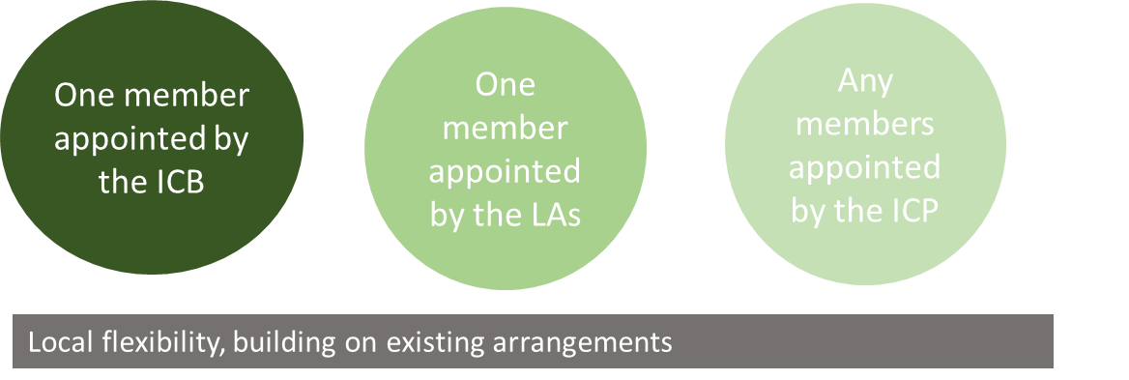
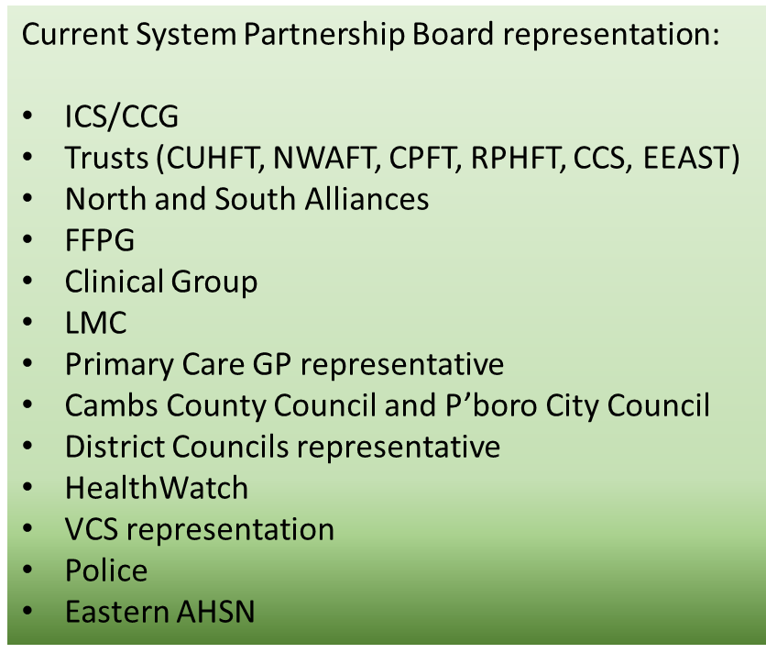
Integrated Care Partnership
Minimum membership requirements:
Please note, additions to membership will proceed, once the
Chair and CEO are appointed and Governance
Representation will then reflect further devolved services to the
ICS (including Chief Pharmacist and LPC, LDC, LOC).

Slide 11
Questions?

