Slide 1
How can community pharmacy work with other pharmacy sectors?
21st September 2021
Sati Ubhi
Chief Pharmacist & Deputy Director

Slide 2
Thank You
Reflections on the pandemic….
Volume of prescriptions
Queues
Closures
PPE/screens
Behaviours
Financial challenges

Slide 3
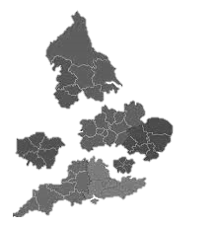
Proposed Operating Framework for Delivery of Medicines Optimisation Priorities
National | Regional | System | Place
Patient & Clinical Pathways
FutureNHS National Prescribing and Medicines Optimisation Network
Geographic Partnerships
Sub-ICS
Medicines Optimisation Board
Regional Medicines
Optimisation Committees
ICS Integrated Medicines Optimisation Committees
(or equivalent)
PCNs / General Practice
Medicines Optimisation
Delivery Group
Community Pharmacy
NHS Providers
Other Medicines Programmes (incl. supply)
Other Medicines Programmes
Other Medicines Programmes
Patients
PLACE
Population based implementation, collaboration & insight.
Cross-sector collaboration and joint working
Partnership working with local authorities, voluntary and community sector.

Slide 4
Current Challenges
Huge pressures on our system (Hospitals, GPs, OOHs, Community Pharmacies)
Increasing polypharmacy - over 14,880 patients taking more than 10 medicines
50% Non-adherence, insufficient medication reviews
Medicines safety issues – e.g. opioid, anticoagulants
Antimicrobial prescribing (Broad spectrum)
Expenditure – system prescribing finances (£350m)
Waste – estimated at around £5 million

Slide 5
Community Pharmacy is key to helping address local health priorities
Based in the heart of our communities able to address inequalities
More face to face contact than any other Healthcare Professional
Established relationships with patients
Easily accessible
Growing clinically focussed services
Expertise to manage conditions helping to reduce pressure on the health system.

Slide 6
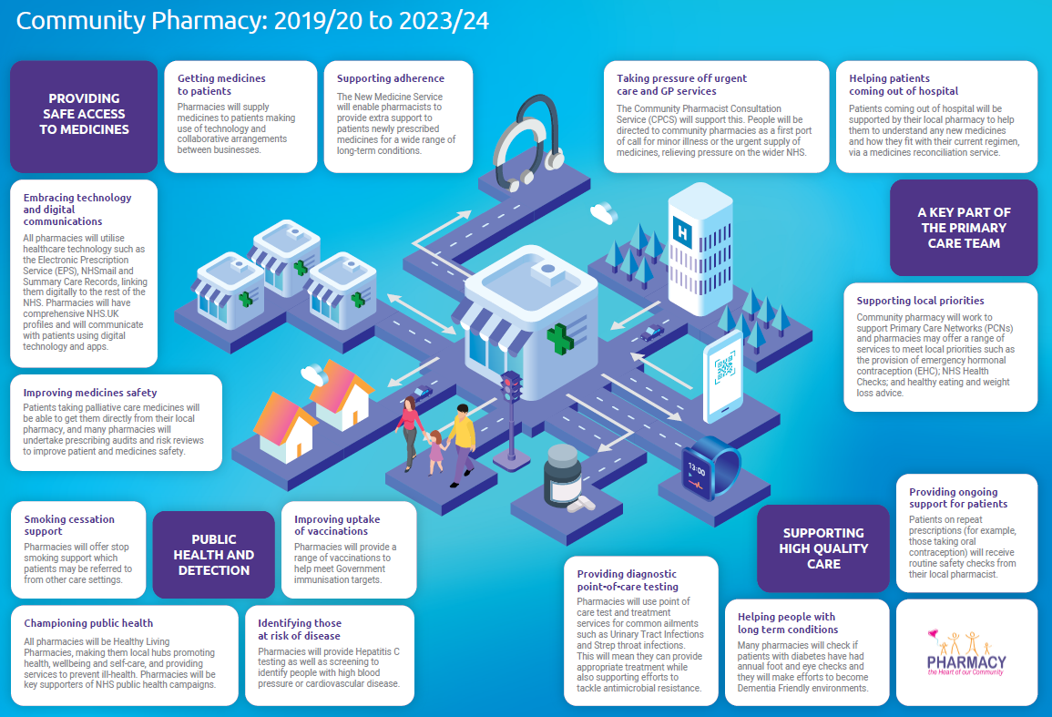

Slide 7
Working through the whole patient journey
Pharmacy Services
Prevention
Early Diagnosis
Treatment
Referral
Monitoring
Smoking Cessation, weight management, vaccination services
Hypertension case finding, AF detection, early cancer diagnosis
Minor ailments, enhanced care services
NMS – Reconciliation & adherence reviews
Hypertension, red flag

Slide 8
Working with Other Pharmacy Sectors
Consultant Pharmacists
Discharge Medicines Service
Community Pharmacy
Hospitals
PCNs
Urgent Care
CCG
Diabetes Group
Smoking Cessation
Vaccinations
Mental Health
GPCPCS
Care Homes
Respiratory Network
CVD Strategy
Efficiencies
Medicines Safety
Clinical Policies/formularies
CPCS

Slide 9
Working Together What we have Learnt
Building on established relationships
Understanding each others worlds
Mutual Aid
Breaking down barriers
Shared purpose

Slide 10
What we do well
Collaboration – bringing sectors together
Area Prescribing Committee
Chief Pharmacist Leadership Group
Workforce strategy
Medicines Safety
Medicines Value Programme
Vaccination Services
Awards & Recognition (self-care, emollients, drug shortages,
primary care prescribing
finances.

Slide 11
Aims for the Future
Integrate community pharmacy fully into our ICS
Understand and collectively work through challenges (workforce, financial etc.)
Support staff development
Create professional clinical networks
Make community pharmacy sustainable for the future

