Slide 1




Discharge Medicines Service (DMS)
Launch of Referrals from North West Anglia Foundation Trust (NWAFT)
Alison Heath, Chair, Cambs and Peterborough LPC
Karen Cox, Support Officer, Cambs and Peterborough LPC
Stephen Cook, Chief Pharmacist, NWAFT
Sophie Castle-Clarke, Principal Advisor, EAHSN
Notes:
.

Slide 2

This Evening Will Cover:
EAHSN Role (Sophie Castle-Clarke, EAHSN)
Overview of Progress in the region and impact to date
Evidence from Published Studies • Local Case Study
DMS & Community Pharmacy (Alison Heath and Karen Cox, Cambs and PB LPC)
Close (8.30pm)
Welcome and Introductions
Q&As
DMS & Hospital Overview (Stephen Cook, NWAFT)
What is DMS? Background & Aims of the service
Community Pharmacy requirements • Referral Method
• Patient and Trust benefits • Referral Criteria
PharmOutcomes • Funding
Notes:
Welcome everyone – including speakers, (who will introduce themselves as we go through) community pharmacy and hospital colleagues.
Housekeeping – everyone to be muted, questions can be posted in the chat as we go through the presentations or save till the end and ask ‘in person’
NWAFT – Peterborough, Stamford and Hinchingbrooke hospitals.
Hand over to Sophie from EAHSN.

Slide 3


Slide 4
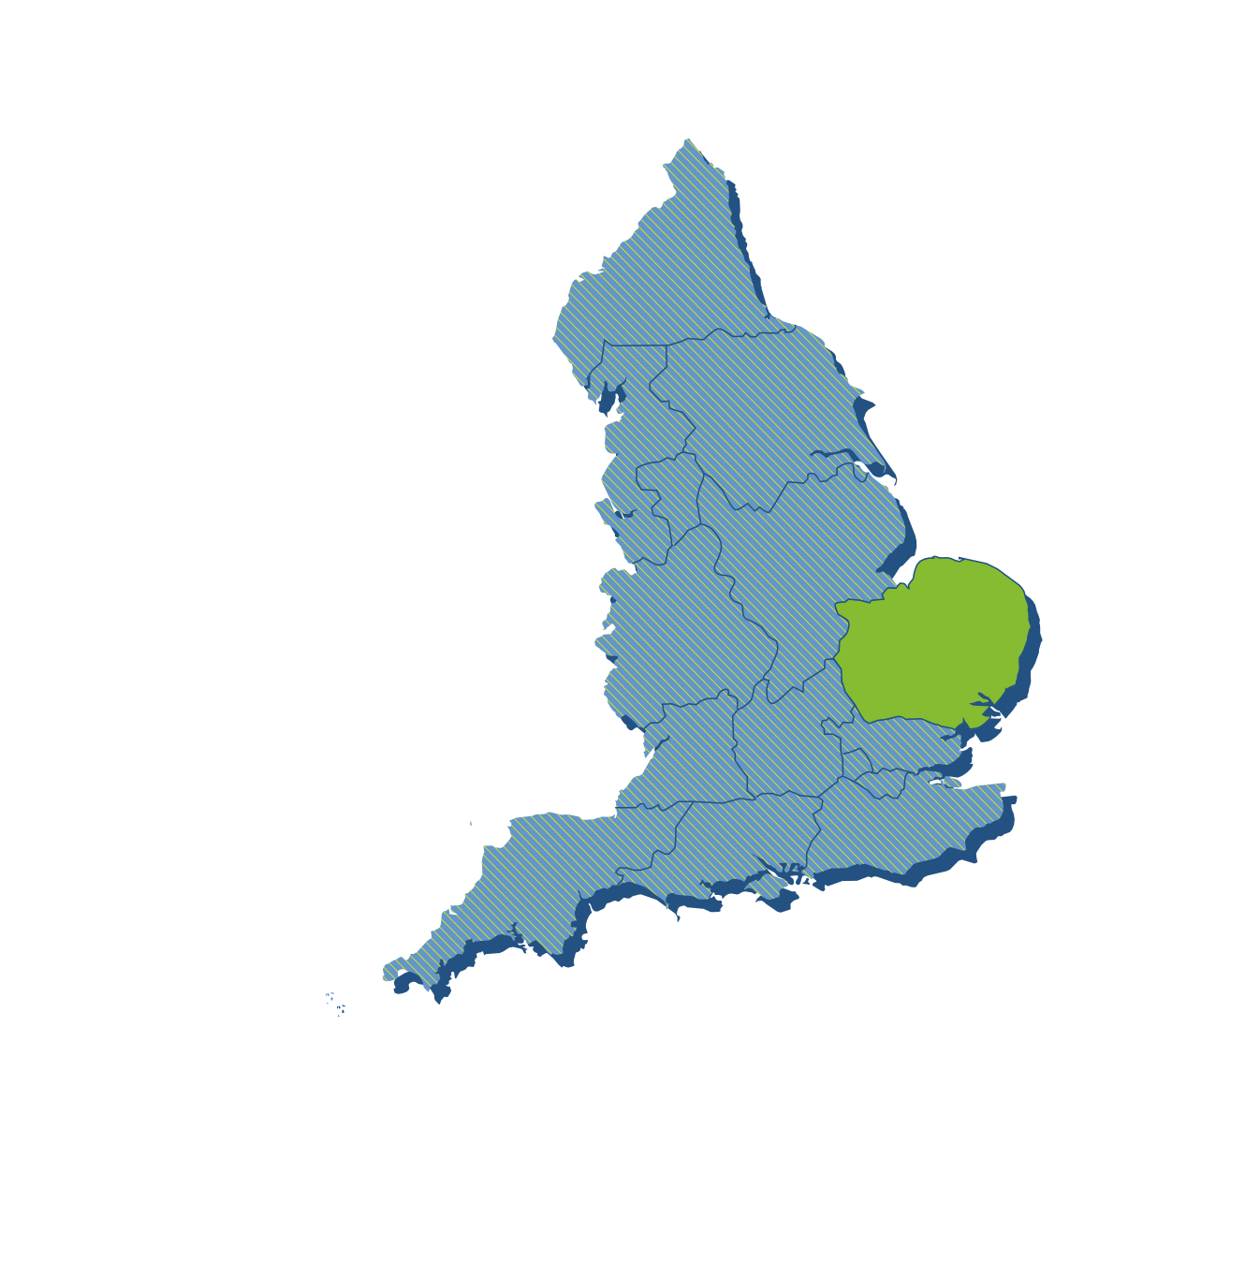

Why Eastern AHSN exists
Eastern AHSN was established by the NHS to convene all partners in the health sector to develop and deliver innovative solutions in health and care.
Our focus is the East
of England, but we are
part of a national AHSN network which enables us to deliver at scale.
Notes:
Eastern AHSN is mandated by the NHS to deliver innovative solutions to health and care challenges across the East of England
We also have reach and connections beyond the region as we are part of a national network of 15 AHSNs throughout England who work together
In addition to being Chief Executive of Eastern AHSN I am also Chair of the national network, so scaling up great ideas from our region to a national level is really embedded in our culture and a real opportunity for innovators
We spend approximately 50% of our time on the adoption and spread of national programmes including patient safety programmes and 50% on locally initiated programmes

Slide 5



Eastern AHSN funders
Eastern AHSN is funded by the NHS and the Office for Life Sciences to bring together academia, citizens, health services and industry to realise the value of innovations more quickly.
We spend roughly half of our time on the adoption and spread of the national programmes delivered by the AHSN Network. We spend the other half on areas of health consistent with the priorities set out in the NHS Long Term Plan in the Eastern region and the areas where our region is best placed to make major advances.

Slide 6
How Eastern AHSN works: From insight to implementation
Insight
Idea
Implementation
Impact
We convene the right people to characterise healthcare challenges and gain deep understanding of
the opportunities
and barriers that
may stand in the
way of change
We help anyone
with a great idea
to develop it into a workable, evidence-based solution that will deliver outcomes in real-world practice
We help innovators navigate complex systems and generate value propositions, support healthcare providers to adopt innovations into practice and provide
a framework to adopt and scale projects at
a national level
Our programmes deliver measurable positive health impact, creating better health outcomes and
more prosperity
for everyone

Slide 7

Programme update: Eastern region
West Suffolk
West Suffolk
Ipswich
Luton and Dunstable
James Paget
Jul ‘18 – Sep ‘18
Oct ‘18 – Dec ‘18
Jan ’19 – Mar ‘19
Apr ‘19 – Jun ‘19
Jul ‘19 – Sep ‘19
Sep ‘19 – Nov ‘19
Dec ‘19 – Feb ‘20
Jan ’21 – Mar ‘21
Apr ’21 – Jun’21
East &
North Herts
Colchester
Bedford
Norfolk and Norwich
Queen Elizabeth, King’s Lynn

Slide 8
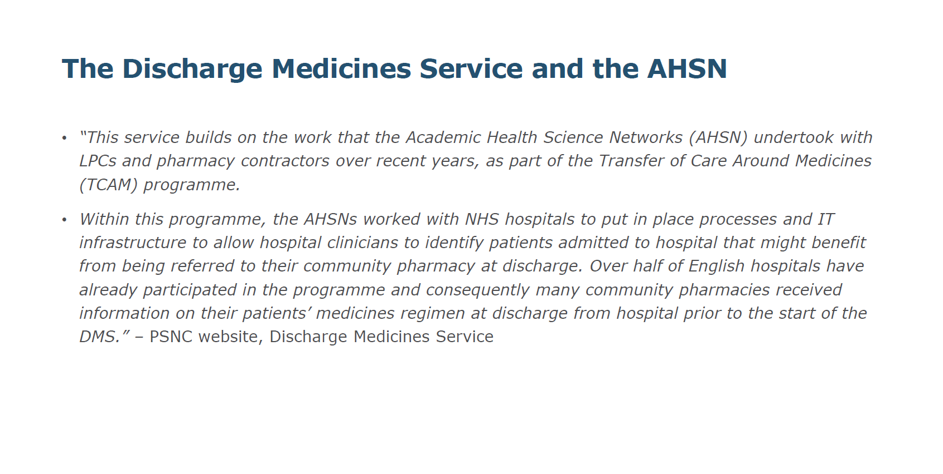

Slide 9
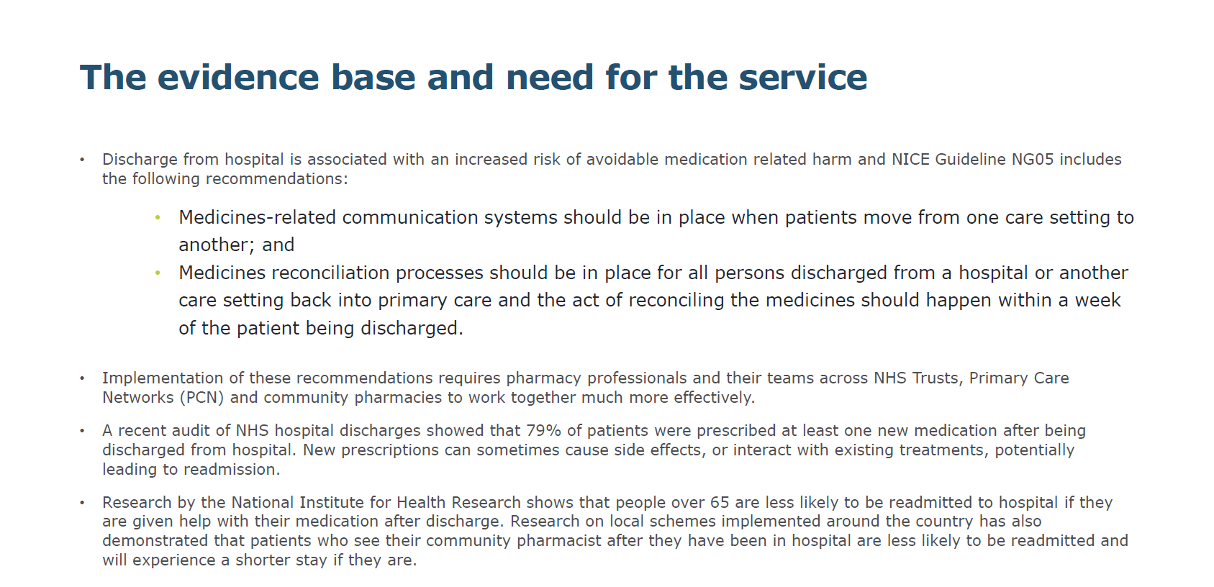

Slide 10
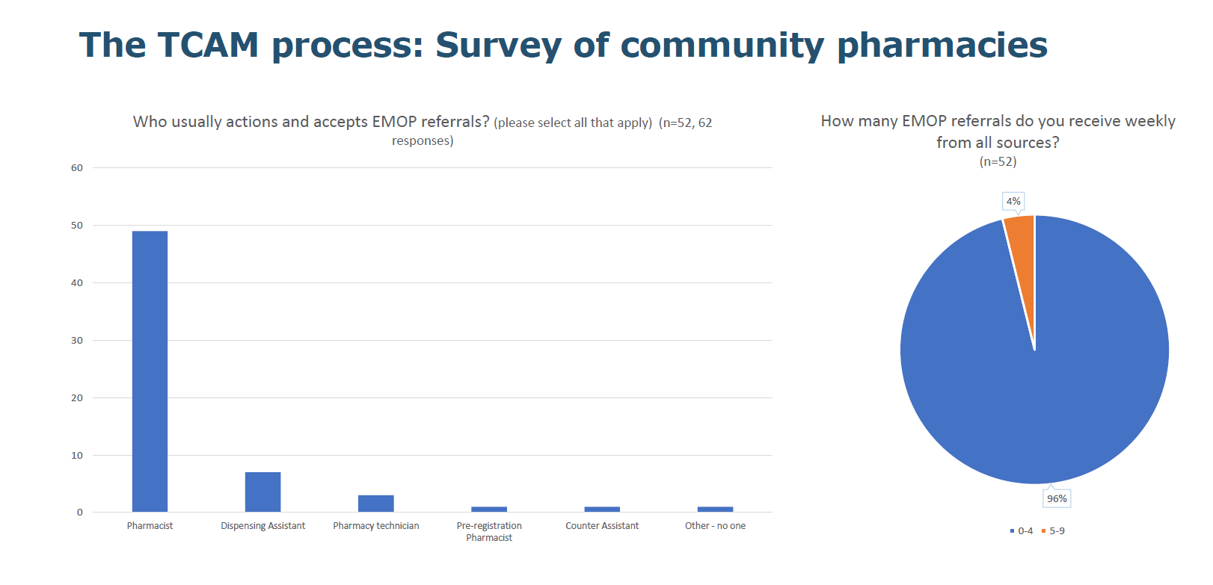

Slide 11
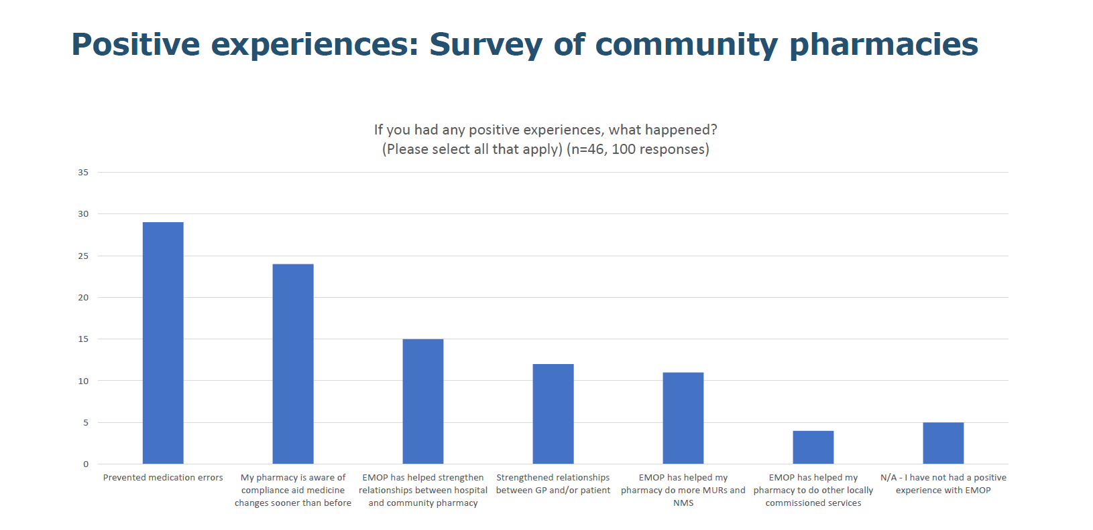

Slide 12
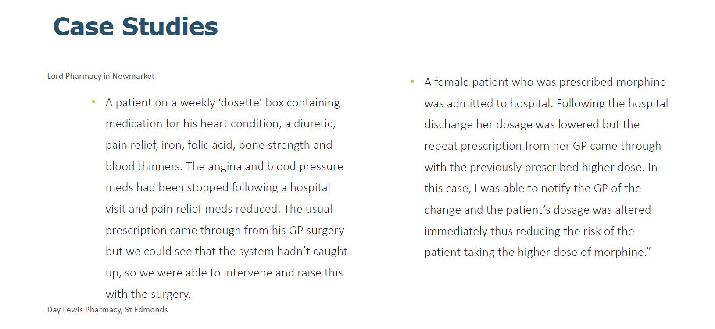

Slide 13
Thank you

Slide 14
Discharge Medicines Service (DMS) & Community Pharmacy
Alison Heath, Chair and
Karen Cox, Support Officer
Cambridgeshire and Peterborough LPC

Slide 15

What is DMS?
The Discharge Medicines Service (DMS) became a new Essential Service within the Community Pharmacy Contractual Framework (CPCF) on 15th February 2021. You MUST act on referrals!
Participating NHS Trusts are now able to electronically refer patients, who would benefit from extra guidance around new prescribed medicines, for provision of the DMS at their usual community pharmacy.
This service builds on the work that the Academic Health Science Networks (AHSN) undertook with LPCs and pharmacy contractors over recent years, as part of the Transfer of Care Around Medicines (TCAM) programme, locally called Electronic Medicines Optimisation Pathway (EMOP)

Slide 16
The Aims of the Service:
The Discharge Medicines Service has been identified by NHS England and NHS Improvement’s (NHSE&I) Medicines Safety Improvement Programme to be a significant contributor to the safety of patients at transitions of care, by reducing readmissions to hospital.
The service seeks to ensure better communication of changes made to a patient’s medicines in hospital and its aims are to:
Optimise the use of medicines, whilst facilitating shared decision making
Reduce harm from medicines at transfers of care
Improve patients’ understanding of their medicines and how to take them following discharge from hospital
Reduce hospital readmissions
Support the development of effective team-working across hospital, community and primary care networks pharmacy teams and general practice teams and provide clarity about respective roles
Notes:
Personal comment from a pharmacist perspective about how useful this information is e.g. patients would present at weekends after being discharged with no meds or confused about which to take….

Slide 17
Staff Training & Competence
Contractors need to ensure relevant staff, including pharmacists and pharmacy technicians, who will be involved in providing the service, have the necessary knowledge and competence to undertake it safely.
As a minimum, pharmacists and pharmacy technicians who will provide the service should:
Read the section on DMS within the NHSE&I guidance on the regulations; and
Read the DMS toolkit.
Additionally, it is recommended that they also complete the CPPE NHS Discharge Medicines Service eLearning and assessment.
Appropriately trained pharmacists and pharmacy technicians must complete the DMS Declaration of Competence and provide a copy of that to the pharmacy contractor.
Other members of staff that support provision of the service must be briefed on the service, with appropriate training provided for any roles they will play. The DMS briefing for pharmacy teams can be used in briefing sessions for pharmacy team members.
Notes:
Slides will be sent out after event so you can access these links.
Stress the DoC will need to be completed before you can access referral information on PharmOutcomes.
We would strongly suggest if you haven’t already you complete the DoC ASAP so you’re ready when the first referral is received. Don’t forget to speak to any locums.
Reminder that technicians can also deliver this service.
Important that the whole team is aware of the service.

Slide 18
Standard Operating Procedure and DMS Go Live Checklist
Contractors must have a Standard Operating Procedure (SOP) for the service, which all staff participating in provision of the service must be familiar with and follow:
The SOP should include the process for checking, on a regular basis, for new DMS referrals.
The NPA have developed a template DMS SOP for their members.
A Contractor DMS Checklist is available: https://psnc.org.uk/wp-content/uploads/2020/12/DMS-implementation-checklist-221220.pdf
Notes:
If you haven’t already we suggest you work through the checklist ASAP before the first referral is received.

Slide 19
How are referrals sent to pharmacies?
NHS Trusts will identify patients who will benefit from the DMS and, obtain patient consent, and send the referral to the pharmacy via PharmOutcomes.
Many of the Hospitals in East Anglia have been live, as EMOP, for over a year, and as DMS since 15th Feb 2021.
Technical issues prevented EMOP rollout for our Trusts but DMS started from Addenbrookes and CPFT over the summer.
Pharmacies can expect to see referrals from NWAFT from November 15th 2021.
You may get referrals from Trusts in other areas via NHSmail.
Remember: this is an Essential Service - you MUST action referrals
Notes:
Highlight that other Trusts outside the area may send referrals via NHSmail so its important to check regularly which they should be doing anyway.
Hand over to Karen.

Slide 20
DMS Pharmacy Pathway
Pharmacy Receives Electronic DMS Referral
Via PharmOutcomes (or NHS Mail)
Stage 1
The Clinical Check
Stage 2
The First Prescription
Stage 3
Involving the Patient
Notes:
Karens first slide.
Stage one – within 72 hours of receipt –, read the discharge information and check for any instructions from the hospital, compare the discharge meds with pharmacy records and check for any rx’s already in the pharmacy that may now be incorrect. Any issues need to be raised with the trust or GP as appropriate.
Stage two – expect to be within one month, but from data usually appears within first week. Compare the rx against discharge note, raise any issues with the GP.
Stage three – confirm patient/carer understanding of changes. Can be telephone call. If in pharmacy consultation room to be used. Could offer to dispose of any meds no longer required and offer other services (e.g. NMS) if appropriate. Consider how this stage will take place for delivery patients.

Slide 21

How to Complete a Referral on PharmOutcomes
https://media.pharmoutcomes.org/video.php?name=DischargeMedicinesServiceManagingDMSReferrals

Slide 22
Funding – Set up fee
Pharmacies on the Pharmaceutical list on 1st February 2021 will have been automatically paid a setup fee of £400 in April 2021.
This was to help you and your team prepare to deliver the service, including staff training and putting in place a Standard Operating Procedure.

Slide 23
Funding – Service provision
Stage 1
The Clinical Check
£12
Stage 2
The First Prescription
£11
Stage 3
Involving the Patient
£12
In certain circumstances, as defined in the Drug Tariff, your pharmacy may not be able to deliver all 3 stages of the service, therefore you may claim a partial payment
Notes:
Circumstances – readmitted to hospital, withdraws consent or changes pharmacy.

Slide 24

Claiming
Your pharmacy will need to make a monthly claim for completed DMS provisions via the NHSBSA’s Manage Your Service portal.
Summary data on each DMS provided will have to be provided to support the evaluation of the impact of the service, contract monitoring and post-payment verification.
Currently PharmOutcomes cannot auto-claim.
Notes:
Must claim on MYS once all three stages are complete. E.g. patient discharged in Nov, but doesn’t collect first rx until Dec claim at end Dec.

Slide 25
Anticipated Numbers
Number of referrals will depend on hospital pharmacy team identifying and discussing with appropriate patients.
No strict criteria- professional judgement
We hope as many as patients as possible will be referred, and this will likely increase with time.
Most pharmacies should see an increasing number, but realistically it will only likely be a few per month initially.
Remember this is an Essential Service – referrals must be actioned

Slide 26
Implementation Tips
Engage and train the whole team
Remember to inform Locums and any temporary staff of your processes
Regularly check NHS Mail and PharmOutcomes for referrals and ensure teams have access at all times. Consider PharmAlarm?
Annotate Rxs clearly with DMS, and keep clear records
Implement a robust process for your team to follow to reduce the risk of missing Stage 2 & 3
Consider using Pop-up messages on the patients PMR to identify patients for Stage 2 & 3
Complete the PharmOutcomes template as you complete each stage and use the partial save function
Keep a list of key surgery contact details for queries
Notes:
Start training and getting the DoC for appropriate staff signed off ASAP.
Remember the partial save

Slide 27
DMS & Hospital Overview
Launch of Referrals from NWAFT Hospitals
Stephen Cook, Chief Pharmacist

Slide 28
Patient benefits
Discharge from hospital is associated with increased risk of avoidable medication-related harm^{[1]}
Discharge is complex and confusing for patients – often done in a rush
The Trust aims to:
  Reduce risks of patients taking medications incorrectly and reduce chances of readmission
  Further utilise the patient’s regular pharmacy to clarify any on-going medication issues post-discharge and increase their capability to act as a support net
Direct referral to community pharmacy schemes (DMS) have been shown to produce significant patient benefits:
  Reduction in Hospital readmission rates (17% and 15%)^{[2, 3]}
  Shorter hospital stays, improved communication with patients^{[3]}

Slide 29
Trust benefits
Improved control over the information shared and exact details of the community professionals its been shared with
Minimise discharge delays
Driver to ensure high quality and targeted information is shared
Modernisation of IT systems & reduced reliance on phone/ email
Improve safe transfer of patients and continuing care
Reduced medicine-related re-admission rates

Slide 30
Hospital process: inpatient interaction
System will go live on both acute sites PCH and Hinchingbrooke
Consent will be asked on medicine reconciliation at the start of the patient’s admission
Explanation of the service, patient information offered
Patient identifies which community pharmacy they use
Identify referral criteria & record on patient’s electronic discharge

Slide 31
Referral Criteria
NWAFT pharmacy services will prioritise referral for:-
  High risk patients – Concordance issues
  High risk medicines – Acute med changes, dose escalations, critical meds
  Monitored Dosage Systems
  The Trust does not currently have a licence for automatic admission data to be reconciled – however we will be reviewing this system option in 2022

Slide 32
Hospital process: discharge
Create DMS document within e-discharge system (EPRO)
Consent confirmed with patient or already documented in medical record
Creates a note based on the discharge/ TTO information and particulars
2. Refer via PharmOutcomes to community pharmacy
Combined e-discharge and pharmacist referral information forwarded
Alerts on community pharmacy screen
3. Community pharmacy reviews and supports patient in community
Concerns directed to Med info helpline: nwangliaft.medicineinformation@nhs.net
Outcomes to be monitored at regular intervals

Slide 33
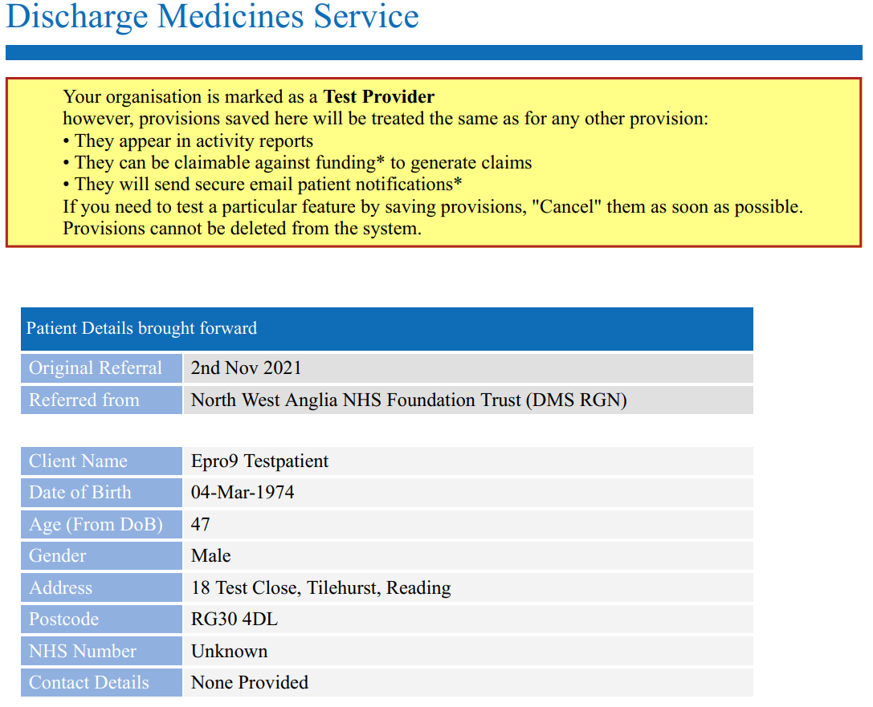
Template EPRO output

Slide 34
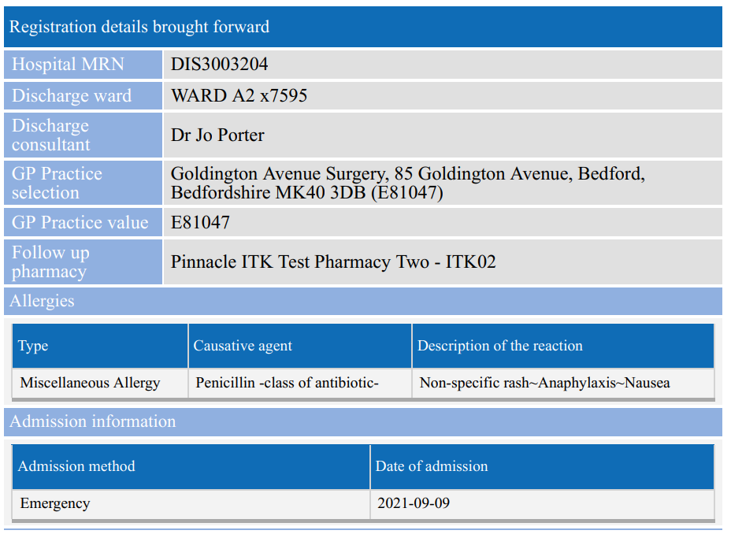

Slide 35
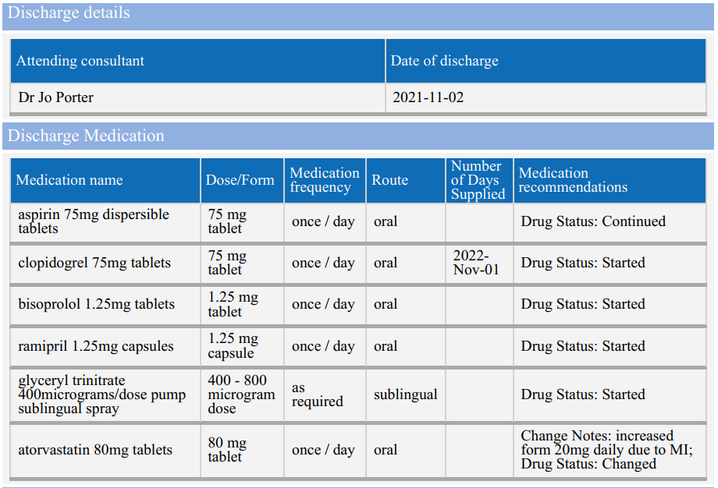

Slide 36
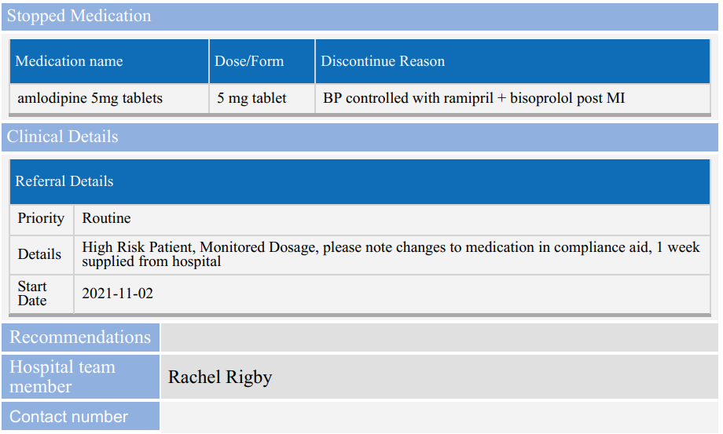

Slide 37
Go Live!
Planned for 15th Nov 2021
Comments, questions via dedicated email: nwangliaft.medicineinformation@nhs.net (please do not send patient identifiable information via this route)
Questions on referrals to be actioned through PharmOutcomes

Slide 38
References
https://apps.who.int/iris/bitstream/handle/10665/325453/WHO-UHC-SDS-2019.9-eng.pdf
Sabir FRN et al (2019) ‘Evaluating the Connect with Pharmacy web-based intervention to reduce hospital readmission for older people’. Available at: https://wessexahsn.org.uk/img/projects/Sabir2019_Article_EvaluatingTheConnectWithPharma.pdf
Hamde N et al (2016) ‘New transfer of care initiative of electronic referral from hospital to community pharmacy in England: a formative service evaluation’. Available at: https://wessexahsn.org.uk/img/projects/BMJ%20Open-2016-Nazar-.pdf

Slide 39

Thank you for attending
If you have any further queries after the session ends please email your LPC supportofficer@cambslpc.org.uk

