Slide 1
New Medicines Service - Depression pilot
March 2023
Flora Phipps & Joanna Fraczek ​
CPFT Specialist Mental Health Pharmacists​
​
Contact details:
flora.phipps@cpft.nhs.uk ​07745739163
joanna.fraczek@cpft.nhs.uk 07742500520

Slide 2
Plan
Time |  | Speaker
10:00 – 10:05 | Welcome & Introduction | Debs Dullaghan/Rita Bali/Clara Ranera
10:05 – 10:20 | Aim & Objectives Consulting with people with depression or other common mental health problems | Flora Phipps
10:20-11:00 | Update on NICE depression guideline 2022 Place of antidepressants and Talking therapy Antidepressants – Pharmacology and clinical consideration | Joanna Fraczek Joanna/Flora Joanna Fraczek
11:00 – 11:30 | Brunch & Networking
11:30 – 11:45 | Signposting and referral | Flora Phipps
11:45 – 12:00 | Scenario – based discussion | Flora/Joanna
12.00 - 13:00 | Pharmacy contractors experience Q&A Conclusion | Debs Dullaghan Flora/Joanna Flora/Joanna
Objectives

Slide 3
Agenda
Aim
To ensure competence of community pharmacists in delivering the new service and to increase the confidence in providing effective advice to patients with depression
Objectives
Consider what is different about consulting with people with mental health problems, and how to prepare for and approach these consultations so that people get the most benefit from them. ​
Refresh knowledge of common antidepressants; how they work, why they are prescribed, their effects and side-effects, and alternative treatments. ​
Enhance skills and confidence to help someone who may be considering suicide and focusses on breaking stigma and encouraging open conversations.​
Use evidence-based judgement to decide when to refer a patient and identify patients who require onward signposting to appropriate guidance and supporting organisations.
​

Slide 4
Mandatory Training already undertaken
Guidance for registered pharmacies providing pharmacy services at a distance, including on the internet, March 2022, GPhC PhIF NHS New Medicine Service (NMS) Expansion in Community Pharmacy Service Specification 11
NMS Self-certification
Centre for Pharmacy and Postgraduate Education (CPPE): Consulting with people with mental health problems (up to 120min)
Royal College of Psychiatrists: Antidepressants (up to 90min)
Royal College of Psychiatrists: Anxiety, panic and phobias (up to 60min)
Zero Suicide Alliance (ZSA) Suicide Awareness Training (up to 20min)
Scenario-based educational videos (up to 30min)

Slide 5
Consulting with people with common mental health problems

Slide 6
What is different?
Consulting with people with common mental health problems
What if they’re suicidal?
How to best support patients?
What is your concern or worry?

Slide 7
How to have those conversations?
SHUSH – active listening tips
Show you care
Give your full attention
Have patience
Listening well to create trust
Slow down, allow time for pause
Use open questions
encourage the other person to reflect, open up and talk
listen to what they are saying, and what they are not saying
Say it back
Show you're listening and you've understood
Without interrupting or offering a solution
Have courage

Slide 8
Empathy
Empathy
fuels connection
Allows for
different
perspective
Recognising emotions
Non-judgmental
Brené Brown on Empathy - YouTube

Slide 9
Consulting with people with depression
Find out what the person already knows and explore ICE
Consider inclusion of younger people’s information. Role of carers?
Explore motivation and identify opportunities for lifestyle conversations and signpost for interventions and further support
Conversations about psychological and social support – how these relate to helping someone get well and stay well from depression

Slide 10
Diagnosis of depression
Criteria for diagnosis of depression [NICE Depression Guidelines, 2022]
Patient answers 'yes' to one of the below questions and symptoms have been present most days, most of the time, for at least 2 weeks:
During the last month, have you often been bothered by feeling down, depressed, or hopeless?
During the last month, have you often been bothered by having little interest or pleasure in doing things?
In addition, patient may present with the below associated symptoms:
Disturbed sleep (decreased or increased compared to usual)
Decreased or increased appetite and/or weight.
Fatigue or loss of energy.
Agitation or slowing down of movements and thoughts.
Poor concentration or indecisiveness.
Feelings of worthlessness or excessive or inappropriate guilt.
Recurrent thoughts of death, recurrent suicidal ideas, or a suicide attempt or specific plan.
What is the first line antidepressant?

Slide 11
Definition of severity by NICE
For mild presentations, antidepressants are not considered the best first line intervention, unless patient choice.
For more severe presentations, antidepressant medication and talking therapy are recommended.
A combination approach is more likely to support patients to overcome their depression
Subthreshold and mild depression = Less severe
(PHQ-9 score less than 16)
Moderate and Severe depression = More severe
(PHQ-9 score 16 or more)

Slide 12
NICE Recommendations
For mild presentations, antidepressants are not considered the best first line intervention, unless patient choice.
For more severe presentations, antidepressant medication and talking therapy are recommended.
A combination approach is more likely to support patients to overcome their depression

Slide 16
What is talking therapy?
IAPT (Improving Access to Psychological Therapies) was set up in 2008 to provide evidence-based therapies.​
​
Insight Counselling in Peterborough - Insight IAPT - Free Talking Therapies​
​
CPFT Psychological Wellbeing Service (PWS)​
Psychological Wellbeing Service (IAPT) | CPFT NHS Trust​

Slide 17
The pharmacist's role
Support medicines adherence by addressing any concerns and beliefs raised by the person about their medicines if feel able to or to consider
Ensure patient is well-informed with current evidence and guidance and the side effect profile with the medication
Empower patient to make informed choices
Promote healthy lifestyle & support self-care/non-pharmacological interventions to enhance well-being
Underpinning – improve access to services

Slide 18
Antidepressants available under the scheme
SSRIs | Licensed indications
Citalopram hydrobromide | Panic disorder
Citalopram hydrochloride
Escitalopram | GAD, OCD
Fluoxetine hydrochloride | Bulimia nervosa, OCD, menopausal symptoms
Fluvoxamine maleate | OCD
Paroxetine hydrochloride | Social anxiety, PTSD, GAD
Sertraline | OCD, panic disorder, PTSD, social anxiety
Other antidepressants | Licensed indications
Duloxetine hydrochloride | GAD, diabetic neuropathy, urinary incontinence
Be aware of some of the licensed indications

Slide 19
Pharmacology - SSRIs
SSRIs are first choice due to their efficacy overdose safety and side effect profile.
They cause inhibition of presynaptic serotonin, which causes an increase in serotonin at the synaptic cleft leading, in part, to the therapeutic effects of SSRIs.
Receptor | Distribution | Effects
5-HT1A | Hippocampus | Regulates sleep, feeding and anxiety (agonists)
5-HT1B | Substantia nigra, basal ganglia | Neuronal inhibition, behavioral changes (agonists)
5-HT1D | Brain | Vasoconstriction (agonists)
5-HT1E | Cortex, hippocampus | Memory
5-HT2A | Platelets, cerebral cortex | Cellular excitation, muscle contraction (antagonists)
5-HT2B | Stomach | Appetite, sleep (antagonists)
5-HT2C | Hippocampus | Anxiety (antagonists)
5-HT3 | Enteric nerves (antagonists) | Vomiting (antagonist)
5-HT4 | Smooth muscle | Gut motility (agonists)
5-HT5(A,B) | Brain | Locomotion (agonists and antagonists)
5-HT6 | Brain | Cognition (antagonists)

Slide 20
Pharmacology – duloxetine & mirtazapine
SNRIs inhibit the reuptake of both serotonin and norepinephrine, however each of them also displays unique pharmacological properties.
Duloxetine demonstrates a dominant serotonergic influence in comparison to its noradrenergic influence, low affinity for dopamine receptors.
Mirtazapine is a strong antagonist at presynaptic 5-HT and NA receptors as well as antagonist at postsynpatic serotonin 5-HT2 and 5-HT3 receptors.

Slide 21
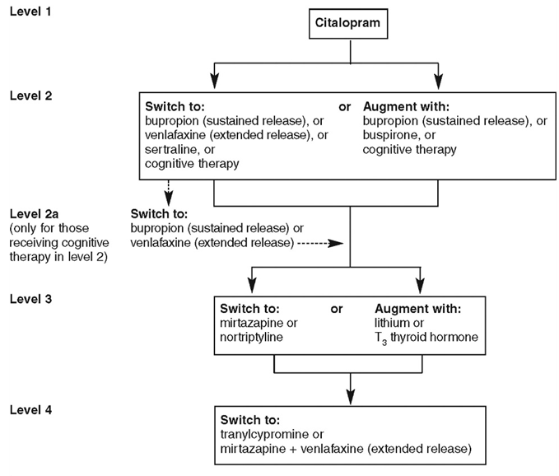
STAR*D trial – 6/10 patients will respond to SSRI/SNRI/CBT
Remission rate = 37%
Remission rate = 31%
Remission rate = 13%
Remission rate = 14%

Slide 22
Pharmacology – pharmacokinetics
SSRI | Half life | Time to steady state | CYP450 inhibition
Citalopram | 33 hrs | 6 days | Nil
Escitalopram | 27 – 33 hrs | 7 – 10 days | Nil
Fluoxetine | 4 – 6 days | 3 – 4 weeks | +++ (2D6, 3A4)
Fluvoxamine | 15 – 26 hrs | 5 - 10 days | +++ (1A2, 2C19)
Paroxetine | 21 hrs | 7 days | +++ (2D6)
Sertraline | 26 hrs | 7 days | + (2D6, 3A4)
Duloxetine | 12 hrs | 3 days | Nil
Mirtazapine | 20 – 40 hrs | 4 – 6 days | + (1A2, 3A4, 2D6)

Slide 23
Pharmacology – pharmacodynamics
Interaction​​ | Explanation​​ | Action​​
SSRI + NSAIDs​​ | Increased risk of GI bleeding​​ | Discourage concomitant use​​
SSRI + warfarin​​ | Increased risk of bleeding​​ | Consider increasing the frequency of anticoagulant monitoring.​​
SSRI + triptans​​ | Increased risk of SS​​ | Monitor for signs of SS​​
SSRI + diuretics​​ | Increased risk of hypoK+​​ | Monitor hypokalaemia​​
SSRI + opioids​ | Reduced metabolism ​ | Monitor for signs of opiate OD​​
Interaction​​ | Explanation​​ | Action​​
Mirtazapine + SSRIs/SNRIs | Increased risk of SS | Rxed by specialist – advise patients of SS
SNRIs + NSAIDs | Increased risk of bleeding | Monitor for bleeding/bruising

Slide 24
Common side effects and management
Side effect | Management strategy
Constipation | Adequate fibre (bran, bulking agents) and fluid intake. Use lactulose, macrogol or stimulant laxatives.
Dry mouth | Sugarless gum and other confectionary that stimulate salivary flow. Artificial saliva sprays; ensure adequate hydration
Gastrointestinal issues | Will subside with time – take medication with food. Report ongoing concerns to GP.
Postural hypotension | Slower dose titration and lower doses are recommended. Tolerance usually develops.
Insomnia | Take the drug in the morning or divide into two smaller doses. Sleep hygiene.
Sleepiness | Residual symptom of depression (?)
Nausea | Take with main meal. OTC prochlorperazine if indicated.
Rash | Discontinue ASAP and seek GP contact
Sexual dysfunction | With SSRIs – speak to doctor

Slide 25
Common myths & misconception
MYTH – it takes 2-4 weeks for antidepressants to work
All antidepressants show a pattern of response within the first two weeks!
MYTH – antidepressants are addictive
Antidepressants do not induce physiological ‘craving’.
MYTH – patients will have to take the medication for years
A single episode of depression should be treated for at least 6–9 months after full remission.
Patients who have had two or more episodes of depression in the recent past should be
advised to continue antidepressants for at least two years.
MYTH – antidepressants make you gain weight
Depression has a negative impact on metabolic control and likewise poor metabolic control
may worsen depression.
SSRIs/SNRIs not associated with weight gain.
Notes:
It is a widely held myth that antidepressants do not exert their effect for the first 2-4 weeks of treatment.
In clinical practice and as per the evidence base, clinical improvement is already seen within the first two weeks of treatment.
The rate of response ‘slows down’ in weeks 4-6. Lack of any response and no visible improvement within the first three weeks of starting
Treatment warrants a change of medication.
About half of those with a first-onset episode recover and have no further episodes.

Slide 26
Common myths & misconception
MYTH – you must not mix alcohol and antidepressants
Alcohol is a depressant so intake is strongly discouraged in depressed patients.
Mixing alcohol can lead to potentiation of side effects.
However, patients are allowed to have a reasonably safe amount of alcohol i.e., glass of wine.
MYTH – you must not get pregnant whilst taking antidepressants
Certain antidepressants are safe in pregnancy and breastfeeding. Refer patient to GP to discuss available options.
MYTH – antidepressants change your personality
Antidepressants only affect neurotransmitters in brain.
They do not cause behavioural nor personality changes in individuals.
Notes:
It is a widely held myth that antidepressants do not exert their effect for the first 2-4 weeks of treatment.
In clinical practice and as per the evidence base, clinical improvement is already seen within the first two weeks of treatment.
The rate of response ‘slows down’ in weeks 4-6. Lack of any response and no visible improvement within the first three weeks of starting
Treatment warrants a change of medication.

Slide 27
Useful focus at each consultation
First consultation – settling expectation
Realistic timeline – at least four weeks for FULL effect, but daily compliance is essential
SSRIs and SNRIs have an activating effect – insomnia, agitation, restlessness may be common in the early days. GI upset may be uncomfortable in the early days.
Mirtazapine has a sedating effect – sleeplessness, grogginess, drowsiness may be common in the early days. Hunger and cravings are a common S/E.
Listen to concerns and reassure where appropriate (myths & misconceptions?)
Stress the importance of a holistic approach to lifestyle – sleep hygiene, diet and physical activity, alcohol intake, social support, psychotherapy
Driving & performance of skilled tasks

Slide 28
Second consultation
Third consultation – compliance check
Explore patient’s experience to identify any medicines-related issues
Support adherence – what does the person need? Reassurance and specific advice?
Opportunities to provide health lifestyle advice and signpost to non-pharmacological support
Improvement – in mental state as well as general well-being?
Emphasize on how continuing the medicine helps the person to stay well
How long to take the medication for and emergence of withdrawal symptoms
The importance of not terminating treatment too suddenly – this can lead to a relapse, with a usually more severe form of depression

Slide 29
At each consultation – opportunities for life-style messages
‘…..if appropriate, offer the patient opportunistic advice on healthy living/public health topics in line with the promotion of healthy lifestyles essential service and signpost them as appropriate to any further mental health support and/or resources available locally or nationally. ‘
Simple healthy living and dietary advice such as healthy eating, increasing exercise or reducing alcohol intake can be beneficial
Simple MECC approach

Slide 30
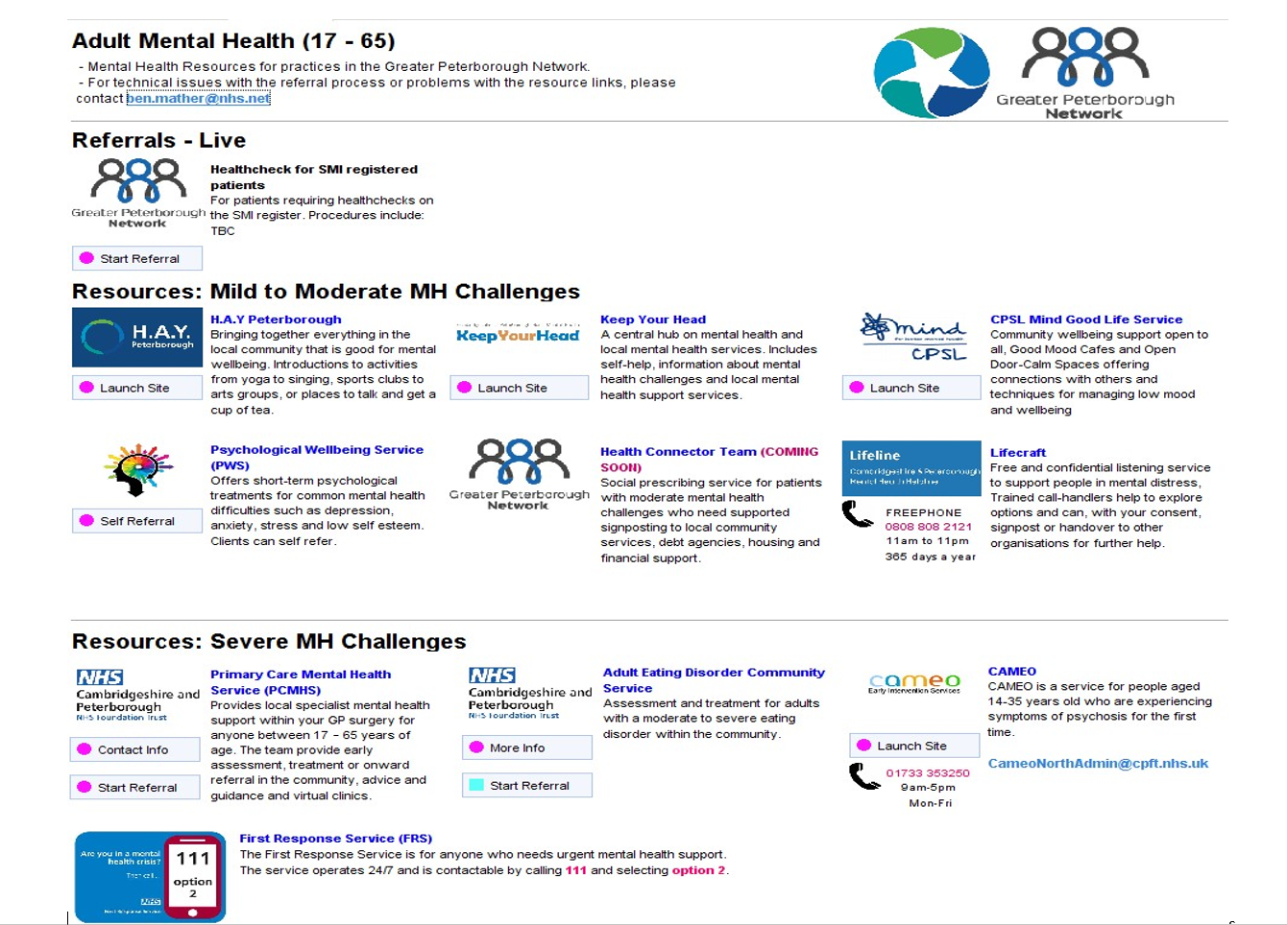
Signposting

Slide 33
Other supportive resources
Choice and Medication© Leaflets are designed to help service users, carers and family members understand their medicines better, and to make more informed decisions, best as part of a discussion with a healthcare professional. Cambridgeshire and Peterborough NHS Foundation Trust Home (choiceandmedication.org)
Information on each drug and printable Patient-Information-Leaflets (some are translated)
Handy fact sheet
Handy book on medicines used for mental health and how they work - care with selecting relevant information only
» Printable leaflets (choiceandmedication.org)

Slide 34
Self-help and well-being support
CPFT self help videos Psychological Wellbeing Service (IAPT) | Self Help | CPFT NHS Trust
Samaritans self-help website and app
Self-Help | Samaritans
CPFT Recovery College East – Wellbeing Hub
RCE | CPFT NHS Trust
Reading Well
Health and Well-being | Cambridgeshire Libraries (spydus.co.uk)

Slide 35
Scenario-based discussion and reflection
Someone with disorganised thinking or overwhelmed
Someone expressing loneliness
Uncertainty around antidepressants
Someone expressing anhedonia
When someone returns feeling worse

Slide 36
Further learning and development

Slide 37
DMS-in-MH-Trusts.-CPs-Educational-Resources-July-2021.pdf (cambsandpeterboroughlpc.org.uk)

Slide 38
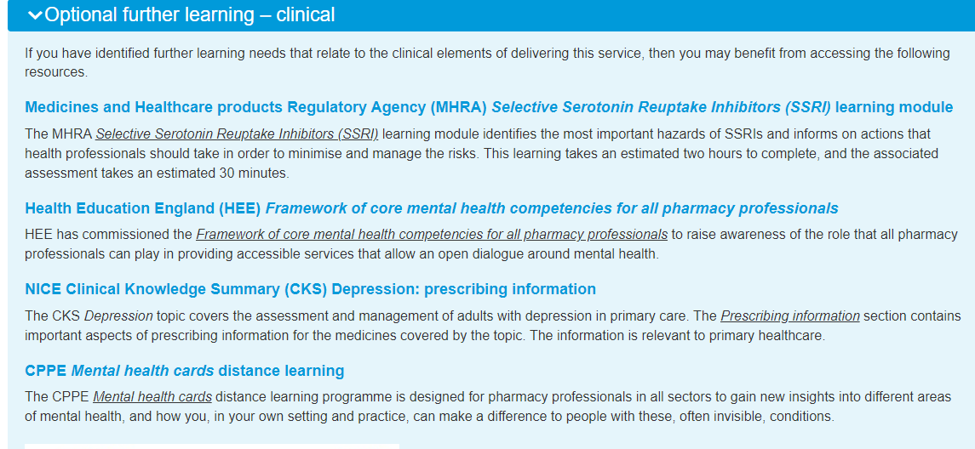
Antidepressants New Medicine Service pilot : CPPE

Slide 39
Staff Wellbeing
NHS Looking after you too
NHS England » Looking after you too
Cambridgeeshire and Peterborough ICS Staff Support Hub
Staff Support Hub
0808 801 0377
staffsupporthub@cpft.nhs

Slide 40
References
National Institute for Health and Care Excellence. Depression in adults: treatment and management (update). Published: 29 June 2022. https://www.nice.org.uk/guidance/ng222
Kendrick T, Pilling S, Mavranezouli I, Megnin-Viggars O, Ruane C, Eadon H et al. Management of depression in adults: summary of updated NICE guidance BMJ 2022; 378 :o1557 doi:10.1136/bmj.o1557
NHS England: NHS Community Pharmacy New Medicine Service (NMS) Expansion Pilot: Inclusion of Depression as a Therapeutic Area and Revised Service Delivery Model Service Specification. Document (cppe.ac.uk)
NHS Health Education England. Framework of core mental health competencies for all pharmacy professionals. December 2020. Pharmacy Framework 2020.pdf (hee.nhs.uk)

