Slide 1
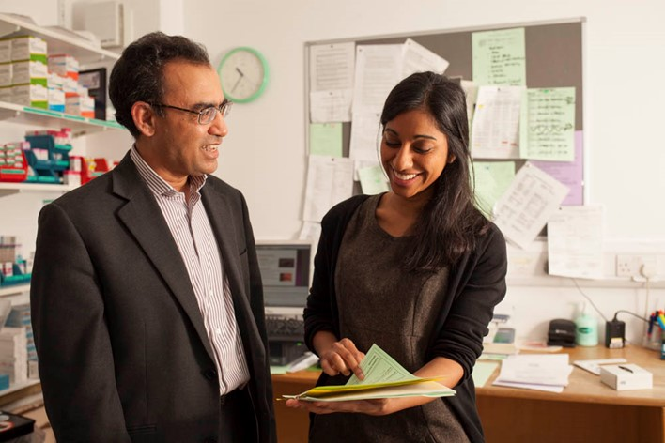
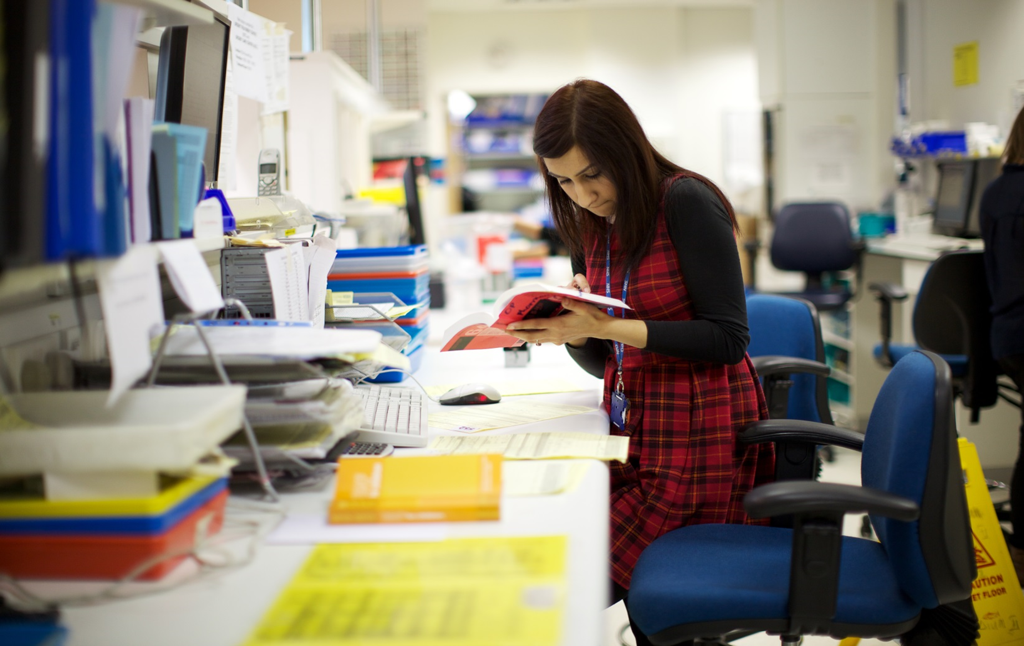
Multisector placements for Foundation Pharmacist Training in East of England

Slide 2
The journey within EOE Pharmacy Sectors

Slide 3
The journey within EOE ICBs

Slide 4
Our vison for the future
Engage and work in partnership with all sector leads and representatives. Informed status and intent - current and potential foundation placement providers at every level
Match training partners across the region to facilitate conversations on the development of joint foundation training (FT) programmes
Support the development of joint FT programmes suitable for inclusion on the 2025-26 ORIEL portal. Multisector rotations of ≥ 13 weeks in preference to external rotation of 8 weeks minimum.
Build up to capacity where all programmes are multisector of ≥ 13 weeks beyond 25/26.
https://forms.office.com/e/i2QZbAZs51

Slide 5
Our vision for the future
Increase the number of multisector posts to 100%
Improve the attractiveness of posts within EOE
Support practices across all sectors to develop partnerships
Increased collaboration with ICS training facilitators
Increased collaboration with Pharmacy ambassadors
ICB workforce teams/ primary care training hubs
Hospital training managers
Community Pharmacy England

Slide 6
What is a multisector rotation
26 week multisector
13 weeks multisector
≤ 13 weeks and up to 8 weeks
Training sites must ensure access to a prescribing learning setting, (90 hours) for the 25/26 training year

Slide 7
ICS Facilitator Contact
ICS | Facilitator Name | Facilitator Email
Mid and South Essex | Anisha Chandaria | Anisha.Chandaria@hee.nhs.uk
Suffolk and North East Essex | Busola Daramola | busola.daramola@hee.nhs.uk
Hertfordshire and West Essex | Leora Sluckis | Leora.Sluckis@hee.nhs.uk
Bedford, Luton and Milton Keynes | Jane Charsley | Jane.Charsley@hee.nhs.uk
Cambridge and Peterborough | Sabaa Naz | Sabaa.naz@nhs.net
Norfolk and Waveney | Ewan Raffel | Ewan.Raffel@hee.nhs.uk

Slide 8
ICS Pharmacy Ambassadors Contact
Abid | Afinwala | abid.afinwala@nhs.net | Mid and South Essex
Jigar | Raval | jigar.raval@nhs.net | Cambridgeshire and Peterborough
Lucy | Beer | lucy.beer@suffolk.nhs.uk; | Suffolk and North East Essex
Rajiv | Nandha | rajiv.nandha@nhs.net | Bedfordshire, Luton and Milton Keynes
Scott | Downham | Scott.Downham1@nhs.net | Hertfordshire and West Essex
Samuel | Taylor | samuel.taylor10@nhs.net | Norfolk and Waveney

Slide 9
NSE-EOE Pharmacy team Contact
Pharmacy NHS England – East of England
Contact via MS Teams: 01223 596912
E-mail address: england.wtepharmacy.eoe@.nhs.net
Address: 2-4 Victoria House, Capital Park, Fulbourn, Cambridge, CB21 5XB

