Slide 1
Community Pharmacy Advanced Smoking Cessation Service (SCS)
Community Pharmacy Cambridgeshire & Peterborough AGM

Slide 2
Background
NHS Long Term Plan (LTP): commitments​
Prevention is a core component of the NHS Long Term Plan (LTP). The LTP commitments that set out the NHS’s contribution to tackling tobacco dependence include:​
By 2023/24 all people admitted to hospital who smoke will be offered NHS-funded tobacco treatment services​
Acute, Maternity and Mental Health services​
The commitments are designed to:​
Be the NHS’s contribution to helping deliver a smoke free generation​
Build on the good work already being delivered and to compliment current Stop Smoking Services​
Focus on both physical and mental health services​
Introduce a level of national direction, but with local development and delivery​

Slide 3
Background (2)
Community Pharmacy Advanced Service Specification – NHS Smoking Cessation Service (SCS) Service Specification
  This service has been designed to enable NHS trusts to undertake a transfer of care on patient discharge, referring patients (where they consent) to a community pharmacy of their choice to continue their smoking cessation treatment, including providing medication and support as required. The ambition is for referral from NHS trusts to community pharmacy to create additional capacity in the smoking cessation pathway
  Smoking cessation programmes already exist in community settings but are variable in their involvement of pharmacy​

Slide 4
Pathway
Hospital Inpatient (undertaking a supported quit attempt)
Locally Commissioned Service
Community Pharmacy SCS
Self care – no transfer of care on discharge required

Slide 5
The Advanced Service Specification
Requirements for service provision, including premises and equipment
  Pharmacist and now Pharmacy Technician (new update to service spec June 2023)
  SOP
  CO Monitor (calibrated and serviced according to supplier specifications)
  Inclusions & Exclusions
  Consultations
  Outcomes & Next Steps
  Consent & Data Sharing
  Training
    https://www.ncsct.co.uk/
      Passed assessments
      Standard Treatment Programme, Specialist modules for mental health & pregnancy, E-cigs

Slide 6
Registration & Payments
£1000 set up >>>>>>READY (competent advisors/NCSCT, CO monitor)
Consultation Fees: Initial £30, interim £10 & final £40
Lost to follow up – inform the trust tobacco team
NRT Reimbursement
Reporting
Registration to provide the service – NHSBSA MYS Portal
CLAIM via MYS
PharmOutcome API

Slide 7
Pharmacy Requirements
Must have satisfactorily completed the National Centre of Smoking Cessation Treatment (NCSCT) Stop Smoking Practitioner Certification
Must have completed specialist NCSCT modules to support treatment for people with mental health condition and pregnant women
Must have completed NCSCT module for e-cigarettes
Must have read the NCSCT Standard Treatment Programme (STD) to support consultations
Pharmacy must have a working CO monitor
Must record consultations on Pharmoutcomes
Tip : Involve staff members to encourage/support patients, contacting patients & diary management

Slide 8
Referral
Following receipt of the referral, the pharmacy to contact the patient within five working days to confirm participation in the smoking cessation service and arrange an initial consultation. At least three attempts to contact the patient (the last of which being on the fifth working day following receipt of referral to ensure patient has a continuous supply of NRT) must be made before closing the referral if the patient does not respond. In this circumstance, please inform The Tobacco Dependency Service
If the pharmacy is able to contact the patient but the patient then declines the referral or does not wish to stop smoking at this time, they should be given details of alternative smoking cessation services. The Tobacco Dependency Service should be informed if the patient’s decision is to withdraw from the service
PharmOutcome Community Pharmacy Receiving Referral Video - https://media.pharmoutcomes.org/video.php?name=NHSSmokingCessationService-CommunityPharmacy
If the patient needs to attend a different pharmacy, data can be transferred to another pharmacy with the patient’s consent. Refer patients onto another Community Pharmacy Advance Service/NHS smoking cessation service provider with patient’s consent if pharmacy is unable to support.
Practitioner/Smoking Advisor can make changes to treatment and pick relevant product from drug tariff.

Slide 9
Key Actions
Service folder within your pharmacy – Locums & Relief Staff
Ensure all pharmacists and pharmacy technicians who will be providing the service have received appropriate training
Develop and review SOP
Read latest service specification
CO Monitors – disposable mouth pieces & calibrate
CPE (PSNC) SCS Page Checklist – Click Here
MYS declarations
Ensure staff have access to PharmOutcomes and NHSmail account
Brief all staff and make sure robust procedures are in place for regularly checking for referrals
Inform local GP practices you will be providing the service
Pharmacies who may not be ready to support patients should de-register (you can re-register) – MYS Portal

Slide 10
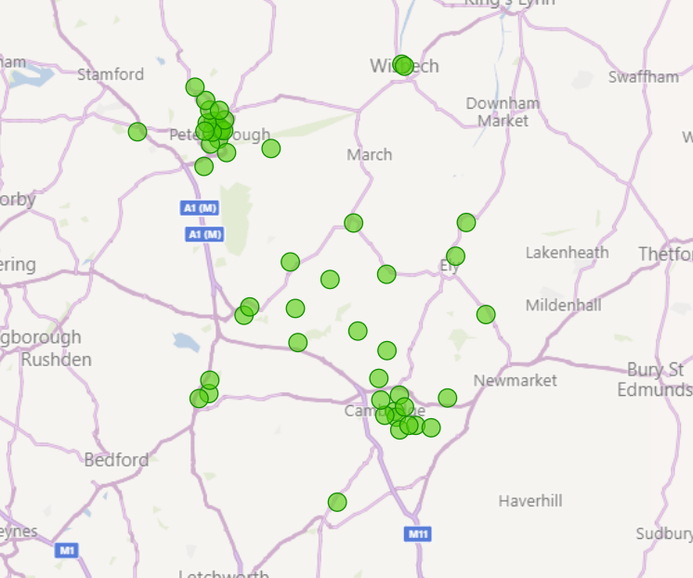
Local picture in C&P (September 2023)
54 registered pharmacies
Royal Papworth Hospital went live in Aug 2023
Soft launch within cardiology
NRT demo kits to aid conversations
Good response from patients
29 referrals since August
2 confirmed quits (28 day) since launch

Slide 11
Useful references
MLCSU dashboard:
https://medsopt.midlandsandlancashirecsu.nhs.uk/nhs-smoking-cessation-service/
CPE (PSNC) page:
https://cpe.org.uk/national-pharmacy-services/advanced-services/smoking-cessation-service/
Future NHS page: https://future.nhs.uk/NHSpp/view?objectID=18882736
Service spec:
https://www.england.nhs.uk/wp-content/uploads/2022/03/PRN00178-community-pharmacy-advanced-service-specification-nhs-scs-v2.pdf/
NCSCT Standard Treatment Programme (STP):
https://www.ncsct.co.uk/pub_NHS-pharmacy-SCS.php

