Slide 1
East of England Regional Pharmacy Technician Leadership Group (PTLG)
Building for the Future
7th September 2023
Presented by:
Regional Pharmacy Technician Leadership Group (PTLG)
Notes:
Standard title slide

Slide 2
Meet the team:

Slide 5
7th September Registration for Expression of interest launched
6th October deadline for submission of EOI
31st October confirmations to be emailed out
21st November First EoE PTLG meeting
17th October Panel meets to decide on membership
Timelines
Expression of interest can be submitted via this form – EOI Form

Slide 6
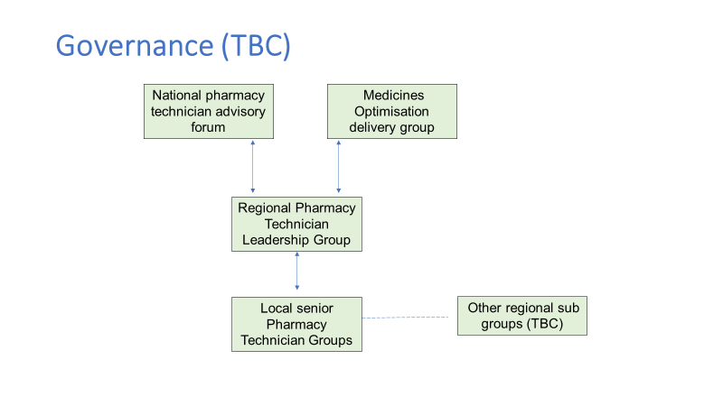

Slide 7
East of England - Pharmacy Technician Leadership Group (PTLG) - FutureNHS Collaboration Platform
Platform to share resources and promote collaborative working across the region

