Slide 1
Local Pharmaceutical Committee AGM 19th September 2023
ICS Update
Sati Ubhi
Chief Pharmacist
Cambridgeshire & Peterborough ICB

Slide 2
Our Progress with Integrating Community Pharmacy within our System
Strategies
Plans
Committees
Relationships

Slide 3
Health & Wellbeing Integrated Strategy
The skills of community pharmacists in optimising medicine usage and understanding, to increase compliance, to reduce medicine wastage and to contribute to acute and long-term condition management must be recognised and supported

Slide 4
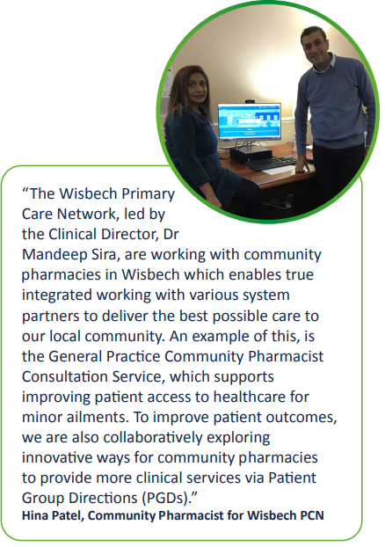
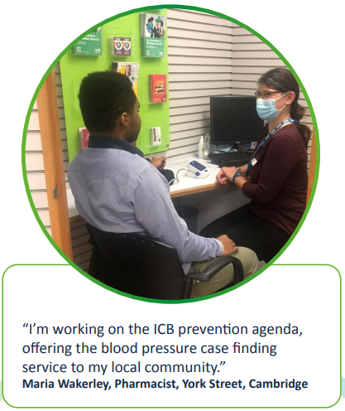
Health & Wellbeing Integrated Strategy

Slide 5
Joint Forward Plan 2023 - 2028
We will…
Work with community pharmacies to enhance opportunities for early intervention and detection of long-term conditions to help support improved outcomes.
Prioritise medicines safety through utilising the community pharmacy workforce expertise in medicines optimisation, helping to reduce waste whilst maximising the benefits for patient care.
Ensure that the full range of care professional and clinical leaders from diverse backgrounds are integrated into system decision making at all levels. As such community pharmacy leaders will be involved and invested in planning and delivery at system, place and neighbourhood level.

Slide 6
Joint Forward Plan 2023 - 2028
Our plans for community pharmacy:
• Increase the use of the DMS.
• Increase referrals via the CPCS
• Increase eRD usage.
• Improve digital connectivity between providers
• Support pharmacies to deliver self-care and self-management
• Expand clinical services
• Enhance opportunities for early intervention and detection
• Upskilling the pharmacy workforce
• Maximise the use of community pharmacy PGDs
• Make best use of prevention services
• Support workforce to minimise unexpected closures

Slide 7
Community Pharmacy Integration with System Committees and Members
ICB Chief Executive Meetings
ICB Chief Officer Visits
Primary Care Commissioning Committee
Primary Care Operational Group
Joint Clinical &Professional Executive Group
Professional & Clinical Leadership Assembly
Joint Prescribing Group
Medicines Safety Group
Medicines Value Group

Slide 8
Key Board Level Members
Board level accountability for medicines via the ICB Chief Pharmacist & ICB Medicines Optimisation Team
Dr Fiona Head
Chief Medical Officer
Bring the perspective and understanding of wider primary care, including community pharmacy providers within the ICB area.
Dr Simon Hambling
Partner Member – Primary Care
Dr Gary Howsam
Chief Clinical Improvement Officer
Develop primary care strategy and quality improvement in primary care.

Slide 9
Local Pharmaceutical Committee AGM 19th September 2023
Dr Gary Howsam
ICB Chief Clinical Improvement Officer

